Slide 1
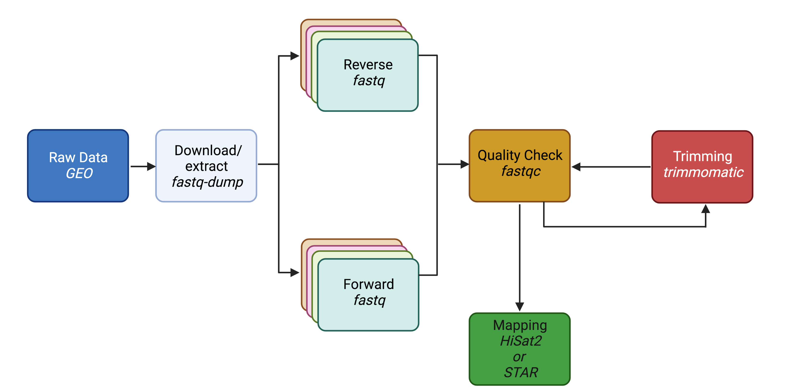
Lecture 8: Mapping
February 21, 2023

Slide 2
Past Topics
This Weeks’ Topics

Slide 3
FASTQC recap

Slide 4
Step 1: FASTQC
Two basic questions of QC
How successful was the actual sequencing?
High base call confidence <30 phred score
Did the library prep generate a faithful representation of the DNA/RNA molecules in the sample?
No contaminations (rRNA, adapters, primers, etc.)
No bias towards fragments of certain GC contents/sizes

Slide 5
Assignment overview
Homework #8
(due 3/1)
Homework #7
(due 2/23)
Homework #9
(due before Spring break)

Slide 6
Trimming

Slide 7
Step 2: Clean the FASTQ files
Raw reads may suffer from the following:
Presence of adaptors
Low quality reads
Or other issues that result in low base call
Trimming is optional
Avoid aggressive clipping as this could cause miss-mapping

Slide 8
Why optional?
Modern “local aligners” like STAR, BWA-MEM, HISAT2, will “soft-clip” non-matching sequences
Other pseudo-aligners like Salmon or Kallisto will not have a problem with reads containing adapter sequences
However, if the data is being used for variant analysis or genome assembly, reads should be trimmed

Slide 9
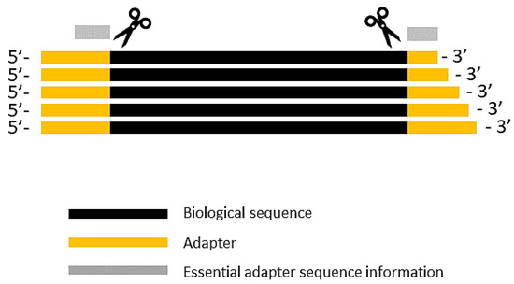
Common programs used for trimming
Preprocessing of FASTQ can be performed by a variety of programs
fastp
Trimmomatic
Trim galore
Cutadapt

Slide 10
How would you run a program on the VACC?
Install it in your personal VACC account and then be able to call it (sratoolkit)
Or load it from the shared computing cluster using module package (fastqc)

Slide 11
Use module to load
module avail – to see what programs are available
module load trimmomatic-0.38-gcc-7.3.0-jwjzei2
Use tab completion!

Slide 12
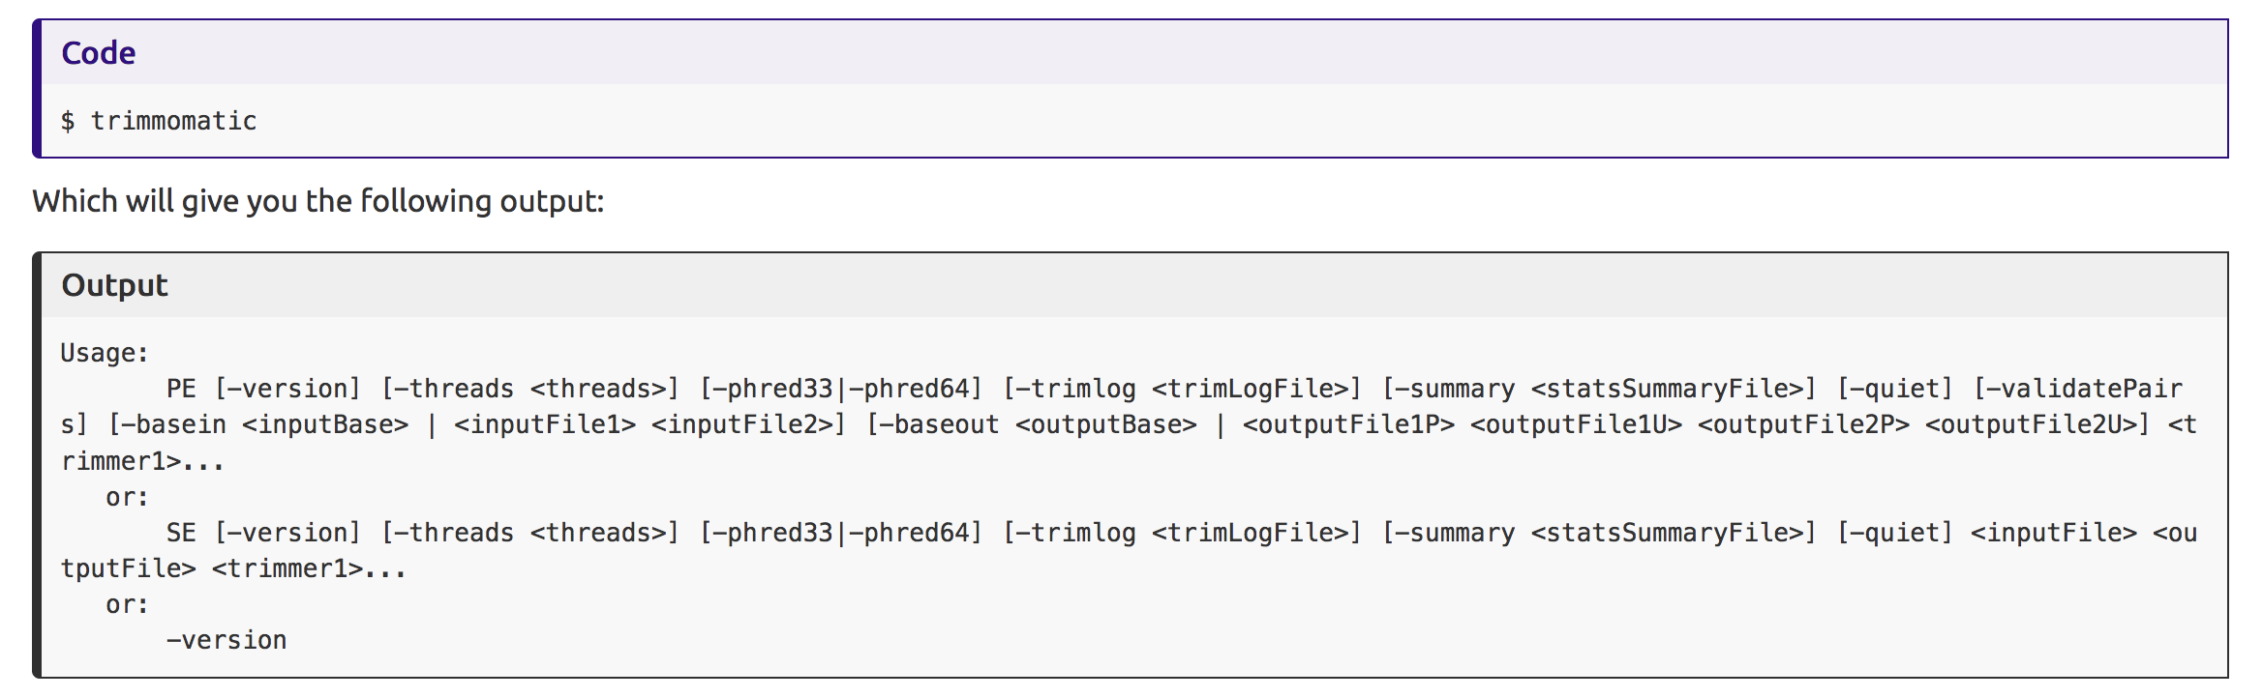
Usage:
Paired-end
single-end

Slide 13
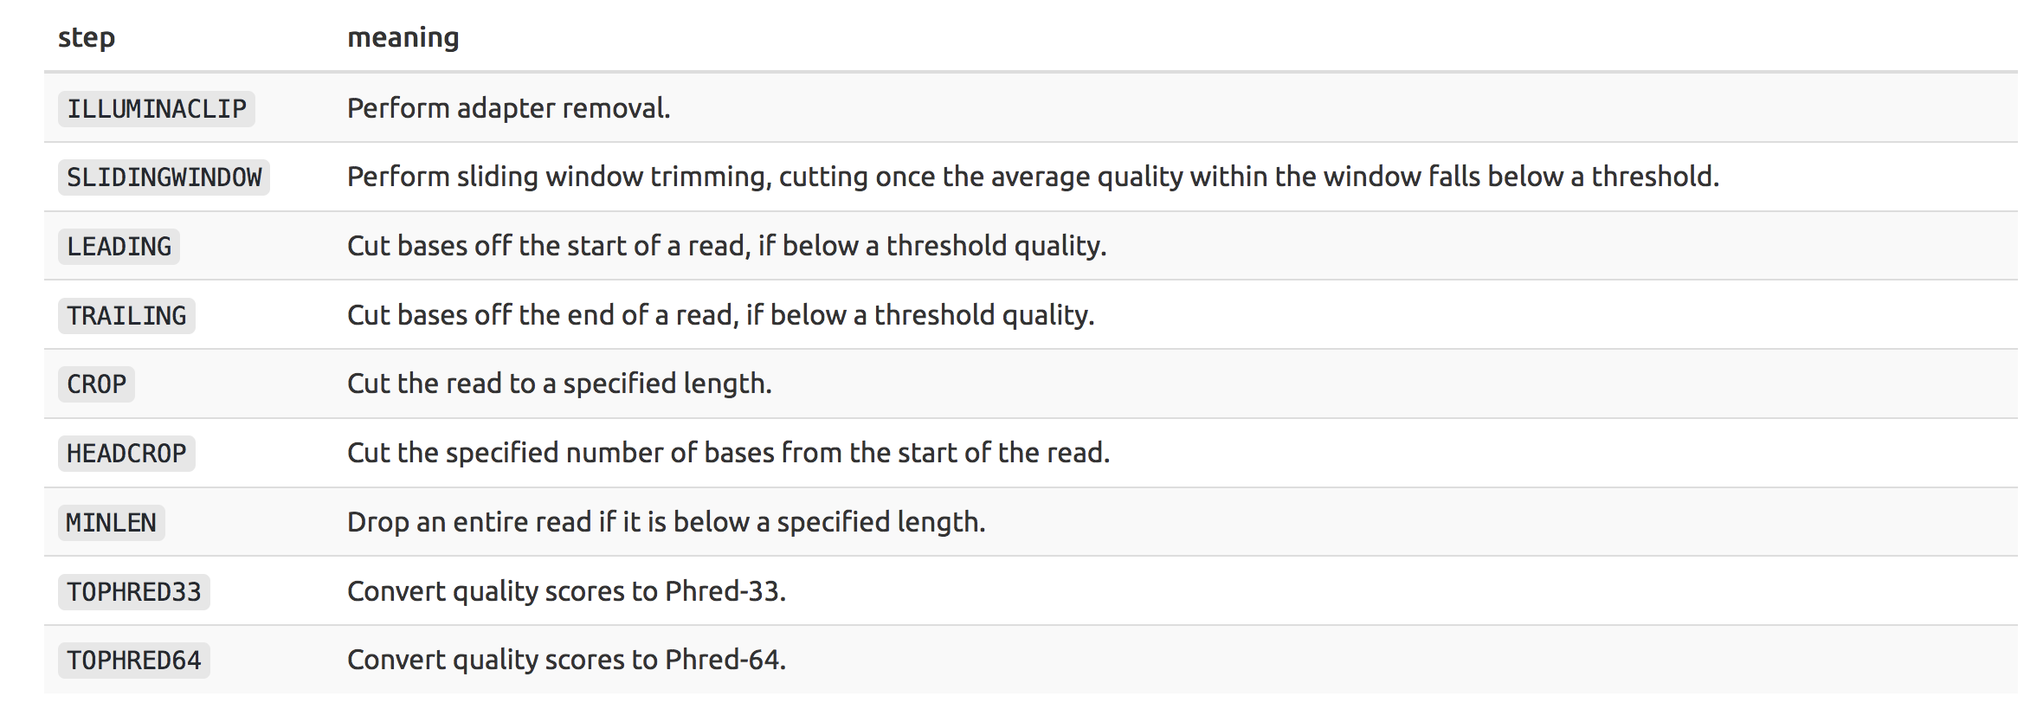
Command parameters

Slide 14
Typical command
trimmomatic input.fastq.gz output.trim.fastq.gz ILLUMINACLIP:~/software/Trimmomatic-0.36/adapters/pick_adapters LEADING:3 TRAILING:1 SLIDINGWINDOW:4:20 MINLEN:60
https://github.com/timflutre/trimmomatic/tree/master/adapters
ILLUMINACLIP: Cut adapter and other illumina-specific sequences from the read.
LEADING: Cut bases off the start of a read, if below a threshold quality
TRAILING: Cut bases off the end of a read, if below a threshold quality
SLIDINGWINDOW: Perform a sliding window trimming, cutting once the average quality within the window falls below a threshold.
Drop reads below the 60 bases long (MINLEN:60)

Slide 15
Output
SRR258199.fastq.qz
SRR258199.trim.fastq.qz
Should be smaller, because you have removed reads
trimmomatic input.fastq.gz output.trim.fastq.gz ILLUMINACLIP:~/software/Trimmomatic-0.36/adapters/pick_adapters LEADING:3 TRAILING:1 SLIDINGWINDOW:4:20 MINLEN:60

Slide 16
Once trimmed, need to run fastqc again!
If bad…

Slide 17
Mapping to Reference

Slide 18
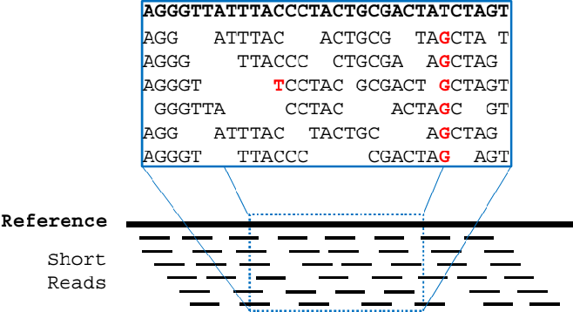
Read alignment / “mapping”
we are identifying the genomic origin of the sequenced cDNA fragment
Notes:
During library preparation, the DNA is fragmented and these fragments arecompletely mixed-up. The goal of read alignment/mapping is to put things back into place i.e. determine which read goes where in the genome. We are identifying the genomic origin of the sequenced cDNA fragment. This is the most crucial step of the entire experiment.

Slide 19
The general challenge
The general challenge of alignment following high-throughput sequencing is to map millions of reads accurately and in a reasonable time, despite the presence of sequencing errors, genomic variation, and repetitive elements.

Slide 20
The challenge with RNA-Seq specifically…
The sequencing library was constructed from transcribed RNA, intronic sequence are not present, and these sequenced molecule natively spanned exon boundaries.
Two categories of reads:
Reads that map entirely within exons
Reads that span two or more exons

Slide 21
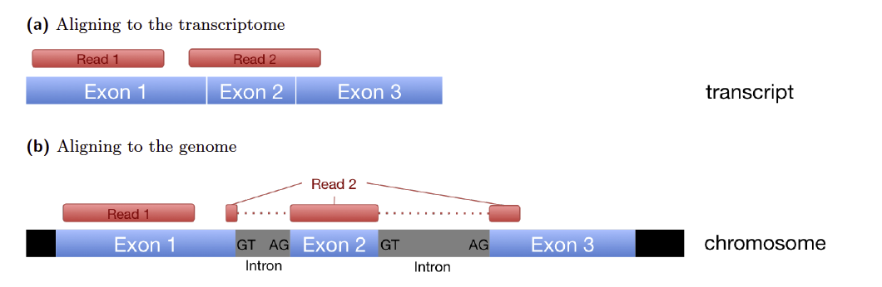





Exon-exon spanning reads
Gene
Isoform 1
Isoform 2
Reads
Notes:
The main challenge of RNA-Seq in particular is the spliced alignment of exon-exon spanning reads and the presence of multiple different isoforms of the same gene.
Short reads can cause ambiguity in mapping different splicing isoforms

Slide 22
Some opt to align to transcriptome instead
If you are mapping reads to a transcriptome intron/exon boundaries are irrelevant
Notes:
To mitigate this problem, there are programs which align to the transcriptome.

Slide 23
Mapping
counts.matrix
1
mapping
(trimmed FASTQ)
GENOME
SAM to BAM
TRANSCRIPTIOME
counts.matrix
2

Slide 24
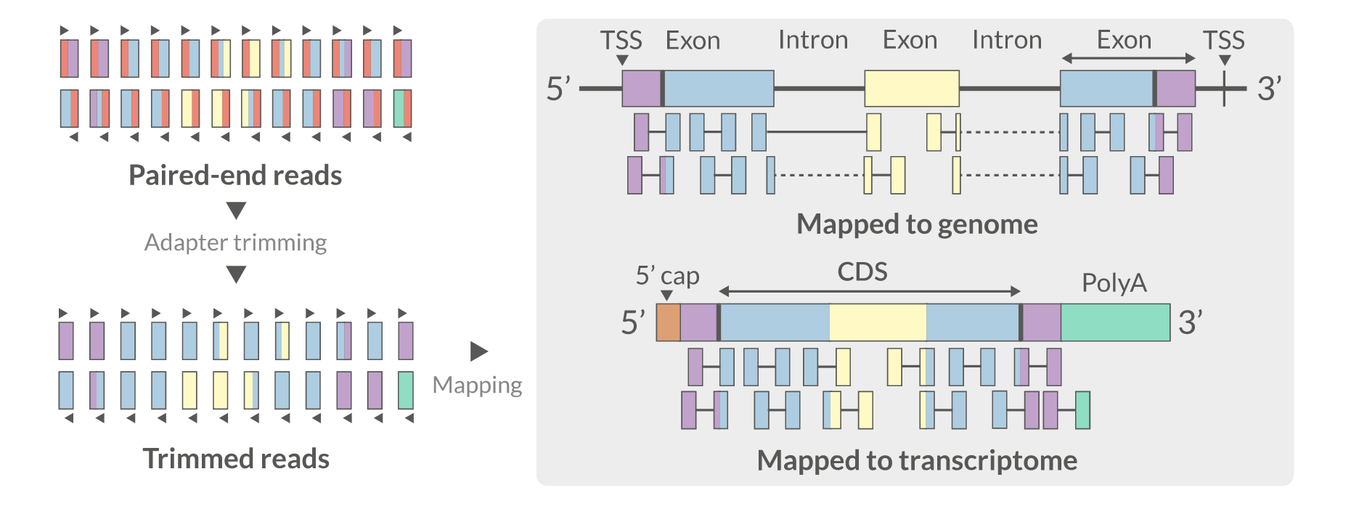
Genome vs Transcriptome?
Red = adapter
Red is gone!

Slide 25
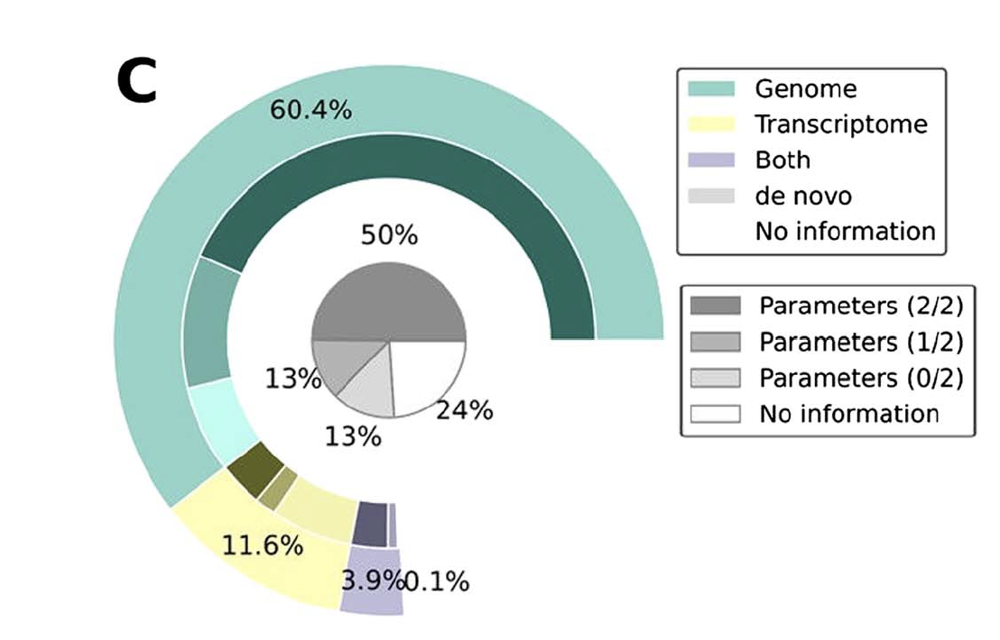
What the scientific community does
Simoneau et al. 2021

Slide 26
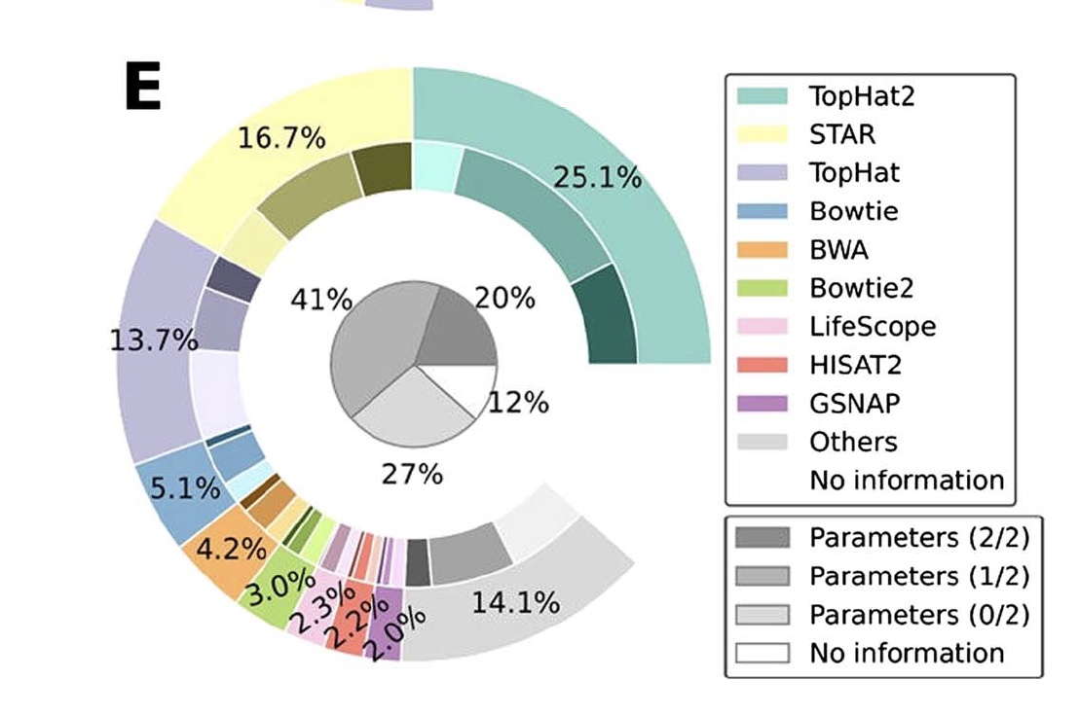
Programs available
Genome
Transcriptome
TopHat2
STAR
Bowtie2
BWA
HiSat2
Salmon
Kallisto
Sailfish

Slide 27
Programs available
Genome
Transcriptome
TopHat2
STAR
Bowtie2
BWA
HiSat2
Salmon
Kallisto
Sailfish

Slide 28
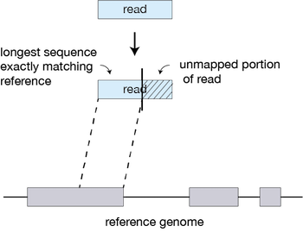
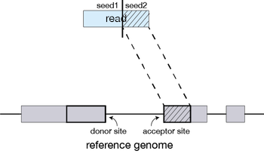
Notes:
STAR will search for the longest sequence that exactly matches one or more locations on the reference genome. STAR will then search again for only the unmapped portion of the read to find the next longest sequence that exactly matches the reference genome, which will be seed2.

Slide 29
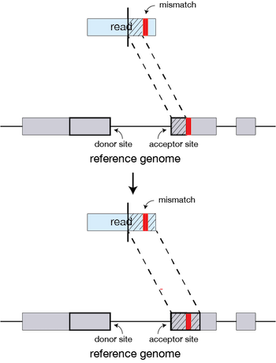
Notes:
If STAR does not find an exact matching sequence for each part of the read due to mismatches or indels, the previous MMPs will be extended.

Slide 30
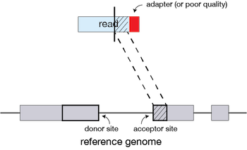
Notes:
If extension does not give a good alignment, then the poor quality or adapter sequence (or other contaminating sequence) will be soft clipped.

Slide 31
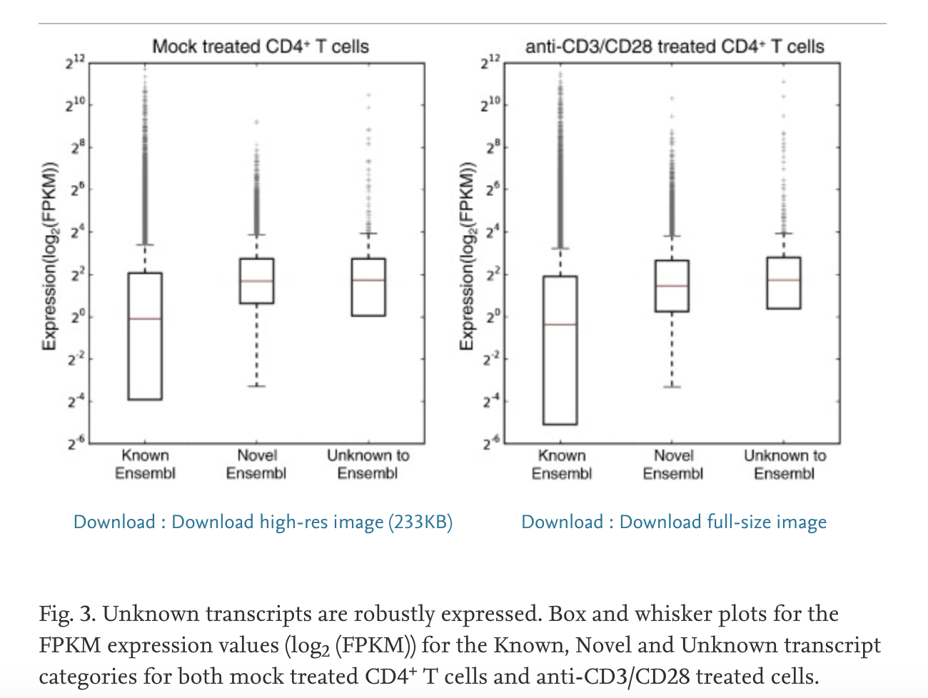
Genome
Transcriptome
Creation of BAM- visualization file
70-90% of RNA-seq reads to map to human genome
Transcript discovery & counting
Mice - Transcripts unknown to Ensembl represent as much as 5% of the transcripts that are robustly expressed
BAM not created
Mapping is only as good as the reference – slightly lower reads mapped
Does not allow for transcript discovery
Hutchins et al.
Notes:
Mapping solely to the reference transcriptome of a known species precludes the discovery of new, unannotated transcripts and focuses the analysis on quantification alone. Alignment to the transcriptome is limited to known transcripts, therefore it is highly dependent on the annotation.

Slide 32
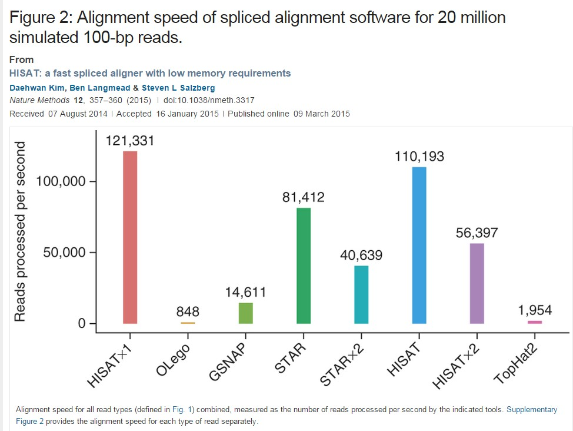
Aligners - Speed and Memory

Slide 33
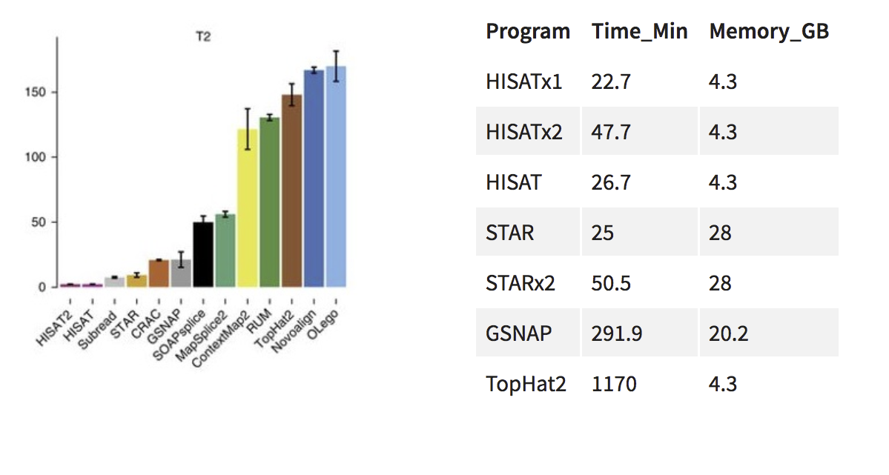
Aligners - Speed and Memory

Slide 34
Reference genomes and annotation
Irrespective of the type of read-mapping, the presence of a reference sequence as well as gene annotation are fundamental
Reference sequence = what are you aligning to?
Gene annotation = which parts of the reference sequence correspond to genes?

Slide 35
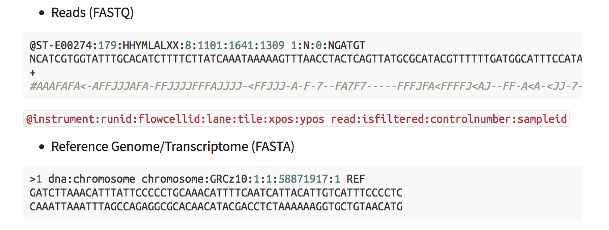
Reference Genome
The reference genome are usually stored in a plain text FASTA file

Slide 36
Annotation
Used to quantify the number of reads which align to different genome features
In the form of a GTF or GFF file

Slide 37
GTF files
Chrom
Feature type
Start
End Strand
Metadata
1 | ensembl | gene | 4430189 | 4450423 . + | . | gene_id | "ENSACAG00000011126"; | gene_name "TMEM1
1 | ensembl | transcript | 4430189 | 4450423 . + | . | gene_id | "ENSACAG00000011126"; | transcript_id
1 | ensembl | exon | 4430189 | 4430804 . + | . | gene_id | "ENSACAG00000011126"; | transcript_id
1 | ensembl | CDS | 4430503 | 4430804 . + | 0 | gene_id | "ENSACAG00000011126"; | transcript_id
1 | ensembl | start_codon | 4430503 | 4430505 . + | 0 | gene_id | "ENSACAG00000011126"; | transcript_id
1 | ensembl | exon | 4439303 | 4439440 . + | . | gene_id | "ENSACAG00000011126"; | transcript_id
1 | ensembl | CDS | 4439303 | 4439440 . + | 1 | gene_id | "ENSACAG00000011126"; | transcript_id
1 | ensembl | exon | 4443852 | 4443930 . + | . | gene_id | "ENSACAG00000011126"; | transcript_id
1 | ensembl | CDS | 4443852 | 4443930 . + | 1 | gene_id | "ENSACAG00000011126"; | transcript_id
1 | ensembl | exon | 4445846 | 4450423 . + | . | gene_id | "ENSACAG00000011126"; | transcript_id
1 | ensembl | CDS | 4445846 | 4446022 . + | 0 | gene_id | "ENSACAG00000011126"; | transcript_id
1 | ensembl | stop_codon | 4446023 | 4446025 . + | 0 | gene_id | "ENSACAG00000011126"; | transcript_id
1 | ensembl | five_prime_utr | 4430189 | 4430502 . + | . | gene_id | "ENSACAG00000011126"; | transcript_id
1 | ensembl | three_prime_utr | 4446026 | 4450423 . + | . | gene_id | "ENSACAG00000011126"; | transcript_id
Tab-delimited text files

Slide 38
Preparation for next class
An understanding of where to find GTF and FASTA files and how they were prepared for use
UNIX command tutorial
cut
grep
paste
sed
awk
Introduction to loops

Slide 39
Where to find genomic files
General biological databases: Ensembl, GENCODE, and UCSC
Organism-specific biological databases: Wormbase, Flybase, CryptoDB, etc. (often updated more frequently, so may be more comprehensive)

Slide 40
General biological databases
UCSC and Ensembl try to organize, unify, and provide access to a wide range of genomes and annotation data
The advantage of downloading from these databanks is that even if you work with different species, the file formats and naming conventions remain consistent

Slide 41
Good practice
Always use the same biological database for all data files (FASTA + GTF)
Always ensure you know exactly which version of a genome and annotation you are working with

Slide 42
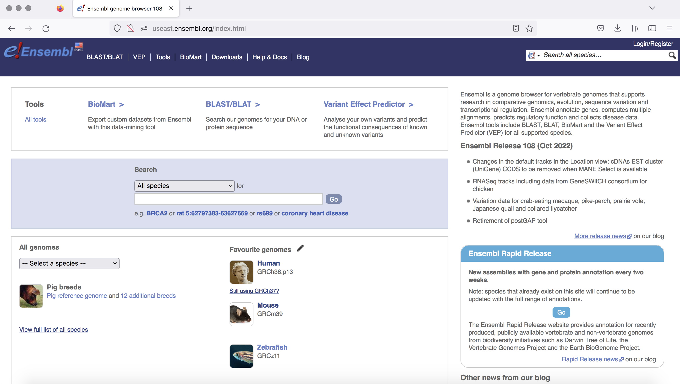
Ensembl

Slide 43
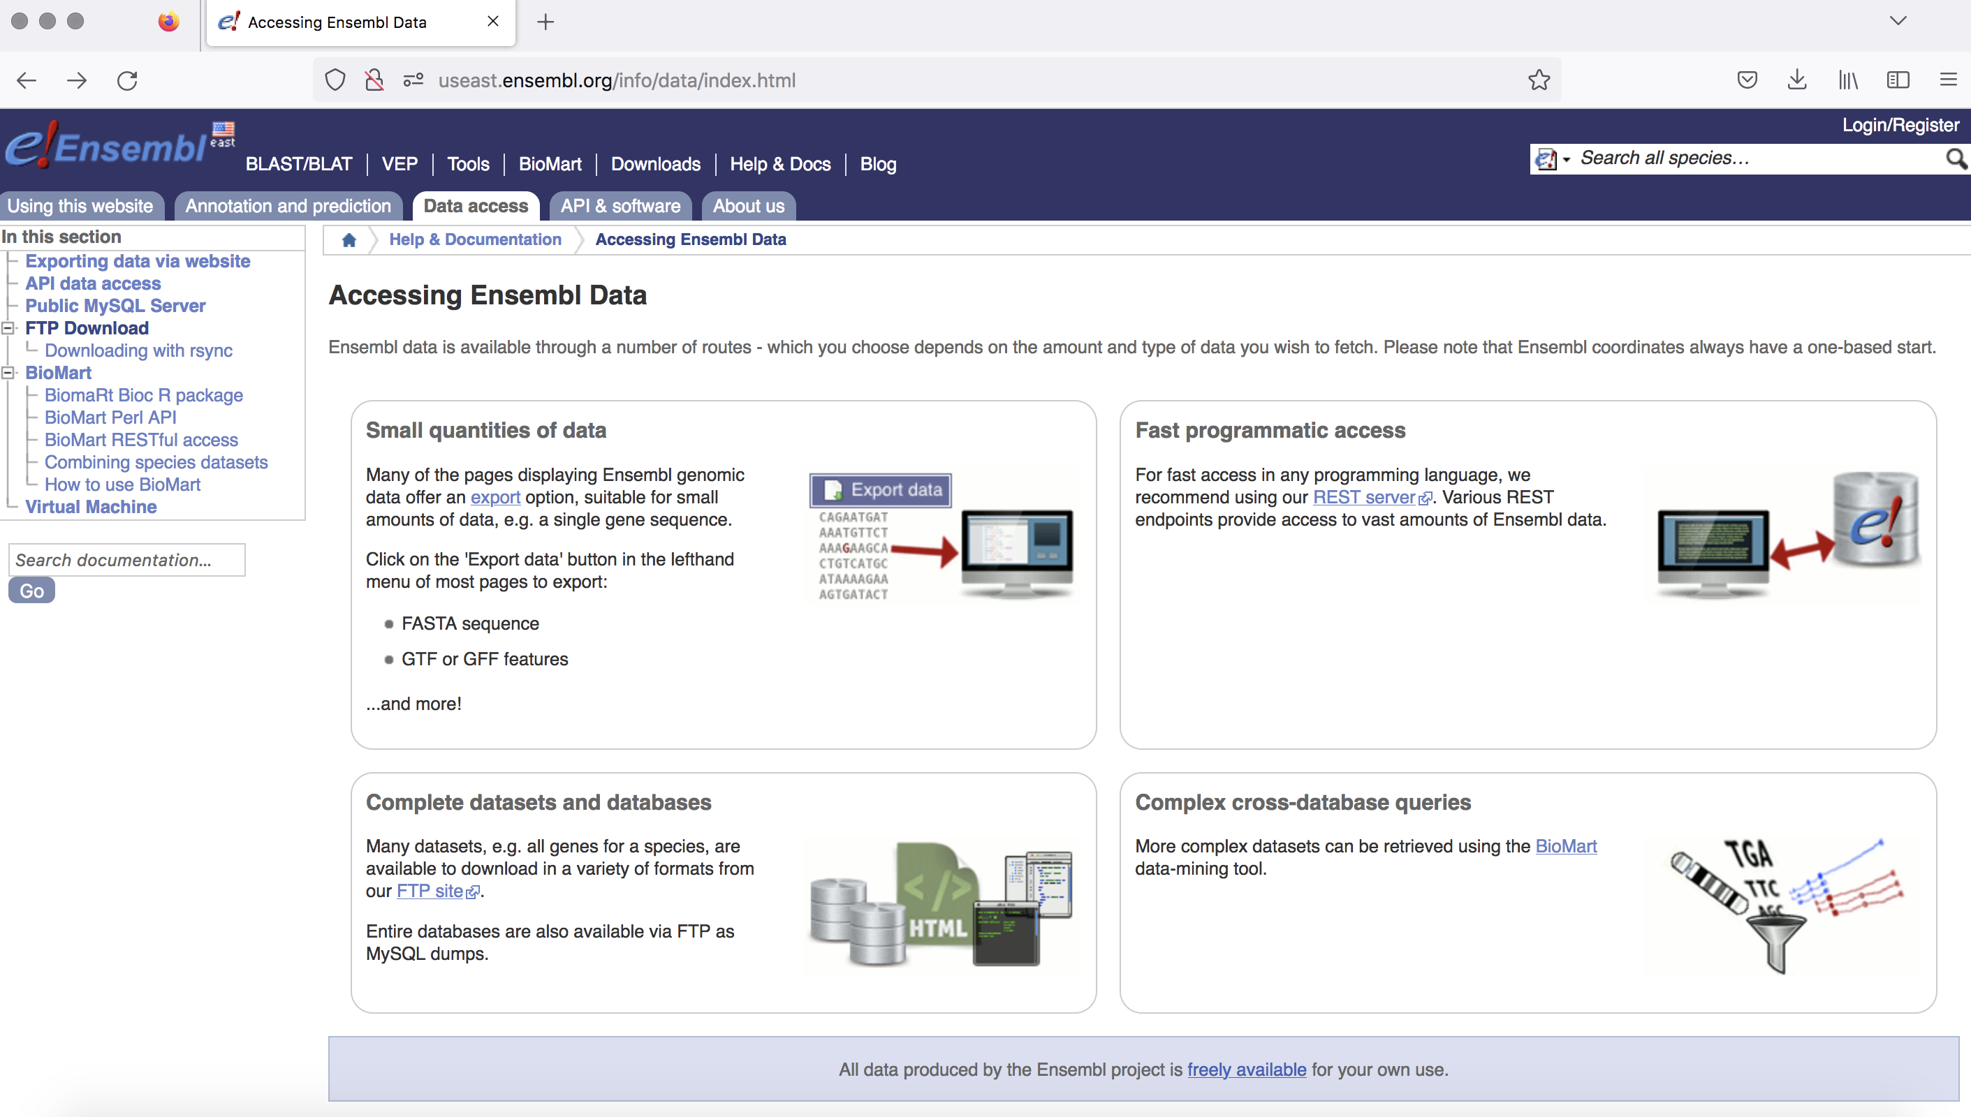

Slide 44
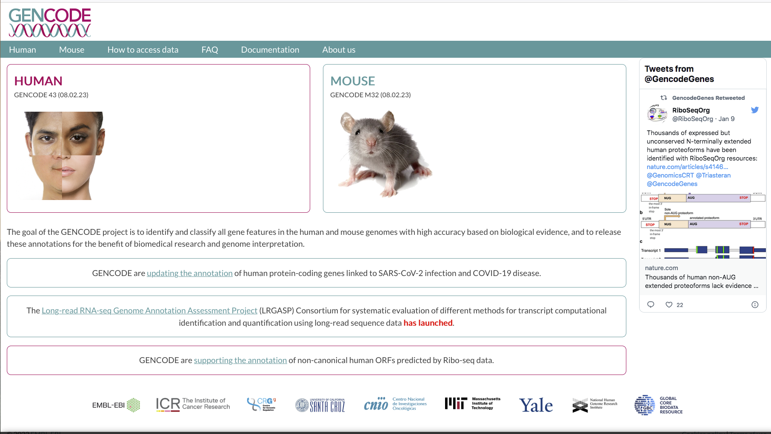
Gencode
https://ftp.ebi.ac.uk/pub/databases/gencode/Gencode_human/release_43/

Slide 45
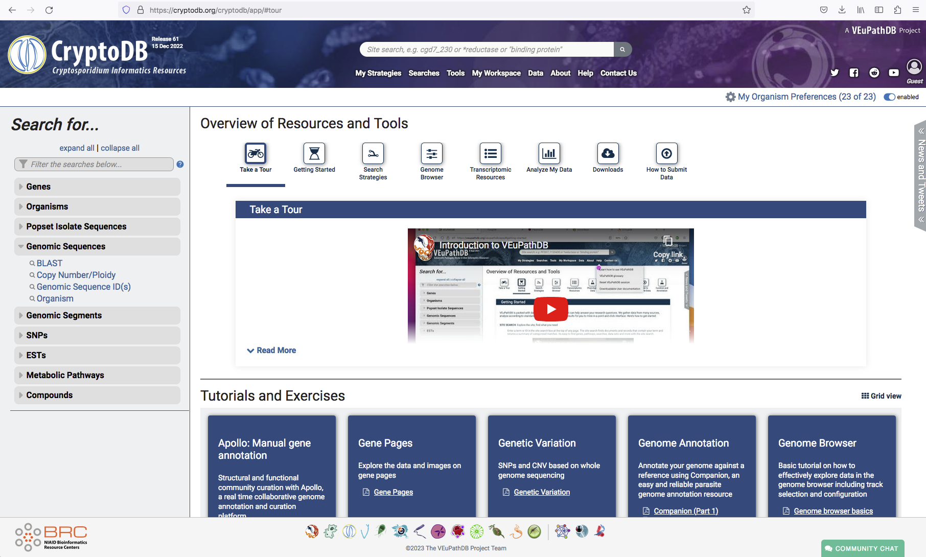
Organism-specific biological databases: CryptoDB

Slide 46
1
2
FASTA
reference
GTF
Indexed Genome*
READY FOR ALIGNMENT

